Slide 1
2015 Utah Nursing Education
Prepared by Clark Ruttinger, MPA
Senior Institutional Research Analyst

Slide 2
Responses and survey updates
18 out of 20 institutions responded
Up from 17 last year.
Previous to 2014 there were typically between 10-12 institutions responding.
No response from Nightingale College and Salt Lake Community College.
Questions added/ changed
NCLEX pass rates broken down by ADN/BSN programs
Budget percentages including government sources
Current Faculty/ Faculty needed by program type.
Dropped 2007 data to increase accuracy
Imputed data in missing years from previous or following year responses where possible.
Most of imputed data is in the 2007-2012 range

Slide 3
Licensed Practical Nurses 2010-2015
% of Total Current Enrollment
Snow | 9%
UCAT | 80%
USU | 11%
SLCC offers a program- data unknown (likely less than 5% of total current enrollment

Slide 4
ADN Programs 2008-2015
% of Total Current Enrollment |  |  |  |  |  |  |  |  | Imputation %
Ameritech | 19% | Eagle Gate | 2% | Snow | 2% | UVU | 9% |  | Applicants | 18%
Dixie State | 5% | Fortis | 6% | USU | 3% | Weber | 28% |  | Students | 18%
SLCC* | 27% | * Imputed from reported data from 3 years ago |  |  |  |  |  |  | Graduates | 18%
Nightingale College also has a program- data unknown (probably less than 3% of 2015 total enrollment) |  |  |  |  |  |  |  |  | Enrollment | 17%

Slide 5
BSN Programs 2008 to 2015
% of Total Current Enrollment |  |  |  |  |  |  |  |  | Imputation %
BYU | 19% | Provo | 2% | U of U | 10% | Western Governors | 23% |  | Applicants | 0%
Dixie | 5% | Roseman | 5% | UVU | 3% | Westminster | 7% |  | Students | 0%
Eagle Gate | 4% | SUU | 5% | Weber | 17% |  |  |  | Graduates | 0%
Nightengale offers a BSN Bridge program- data unknown |  |  |  |  |  |  |  |  | Enrollment | 10%

Slide 6
Nursing Masters Programs 2008 to 2015
% of Total Current Enrollment
BYU | 9% | UVU | 2% | Western Governors | 33%
U of U | 14% | Weber | 14% | Westminster | 29%
Imputation %
Qualified | 9%
Accepted | 12%
Graduated | 11%
Enrollment | 6%

Slide 7
DNP Programs 2008 to 2015
% of Total Current Enrollment
Rocky Mountain | 4% | U of U | 96%

Slide 8
Nursing PhD Programs 2008 to 2015
U of U | 100%

Slide 9
Student Age 2014-2015
 |  | Age 17-20 | Age 21-25 | Age 26-30 | Age 31-40 | Age 41-50 | Age 51-60 | Age 61+ | Age Unkn
LPN | 2014 | 5% | 37% | 22% | 23% | 5% | 2% | 0% | 5%
 | 2015 | 6% | 39% | 26% | 22% | 6% | 1% | 0% | 0%
ADN, Generic | 2014 | 4% | 28% | 29% | 28% | 7% | 3% | 0% | 0%
 | 2015 | 9% | 38% | 21% | 21% | 8% | 2% | 0% | 1%
ADN, Bridge | 2014 | 10% | 40% | 22% | 21% | 6% | 2% | 0% | 0%
 | 2015 | 2% | 34% | 17% | 22% | 7% | 3% | 0% | 13%
Pre-License BSN, Generic | 2014 | 55% | 30% | 8% | 5% | 2% | 0% | 0% | 0%
 | 2015 | 9% | 56% | 11% | 19% | 4% | 1% | 0% | 0%
Post-License BSN | 2014 | 0% | 14% | 23% | 35% | 18% | 10% | 0% | 0%
 | 2015 | 0% | 18% | 23% | 35% | 17% | 7% | 0% | 0%
BSN- Second Degree | 2014
 | 2015 | 0% | 37% | 47% | 13% | 3% | 0% | 0% | 0%
Master's In Nursing- Clinical | 2014 | 0% | 35% | 24% | 26% | 11% | 4% | 0% | 1%
 | 2015 | 0% | 6% | 34% | 50% | 10% | 2% | 0% | 0%
Master's In Nursing Non-Clinical | 2014 | 0% | 4% | 10% | 32% | 27% | 18% | 1% | 9%
 | 2015 | 0% | 6% | 16% | 36% | 28% | 12% | 0% | 1%
PhD | 2014
 | 2015 | 0% | 4% | 0% | 38% | 0% | 50% | 8% | 0%
DNP | 2014
 | 2015 | 0% | 9% | 29% | 43% | 14% | 5% | 0% | 0%

Slide 10
Student Diversity 2014-2015
*Hispanic figure is a percent of total students- not to be summed with other chart values

Slide 11
State and National Workforce Comparisons

Slide 12
BSN Grads as % of total RN grads 2008-2015
Notes:
Hesitancy to project a growth trend to predict when BSN prepared grads reach 80% since there is little available information about what programs intend to do into the future. Will ADN programs continue to grow? Will BSN programs grow? Will new programs be created or converted into BSN programs?
If we do use this past 7 years as a predictor for the future, BSN graduates are gaining share of total RN grads at a rate of about 7% per year.

Slide 13
Projected Estimate of BSN Prepared Growth
Notes:
This projection assumes that BSN programs will continue to grow as a % of RN programs (which may not be true).
It accounts for what appears to be a very slight slowing of the growth rate each year (1%).
Program specific plans for growth would need to be taken into account to get a more accurate projection.

Slide 14
Utah RN Workforce 2015 (From 2014 RN Supply Survey)
76% of RNs licensed in Utah reported their state of initial licensure being Utah
64% of RNs whose initial license was not in the state of Utah report preparation at a BSN degree or higher
Notes:
BSN Graduates aren’t exactly the metric we are looking for in measuring the RWJ goal, although they do eventually translate into the RN workforce.
The majority of RNs whose initial license came from another state are BSN prepared or higher. This means we are importing more BSNs

Slide 15
Faculty Diversity 2015
 | Utah Workforce | Utah Population | National Workforce | National Population
American Indian | 0.5% | 1.5% | 1.0% | 1.2%
Pacific Islander | 0.4% | 1.0% | 1.0% | 0.2%
African American | 0.7% | 1.3% | 6.0% | 13.2%
Caucasian | 92.9% | 91.6% | 83.0% | 77.7%
Asian | 1.8% | 2.3% | 6.0% | 5.3%
Non-white sum | 3.4% | 6.1% | 14% | 19.9%
Hispanic/Latino | 2.2% | 13.4% | 3.0% | 17.1%
Faculty- 2% Hispanic

Slide 16
Faculty Age 2014-2015

Slide 17
Faculty Retirement 2008-2015

Slide 18
Faculty Need 2015
Notes:
High need for BSN faculty could be an indicator that the trend toward 80% BSN prepared workforce is on track

Slide 19
RN Demand 2015
Wage match with all licensed nurses in the state through DWS unemployment insurance data.
List of all employers that hire nurses by North American Industry Classification System code (NAISC)
General Medical and Surgical Hospitals,
Psychiatric and Substance Abuse Hospitals,
Specialty Hospitals ,
Skilled Nursing Facilities,
Home Health Care Services,
Ambulatory Care,
Public Health Facilities,
Office of Miscellaneous Health Practitioners,
Office of Physicians,
Outpatient Care

Slide 20
Response Rates
Only about 20 states are collecting some form of demand data.
Utah’s respondent list and survey is very robust compared to demand data that other states are collecting.
Response Rates | Hospitals/ Health Systems | Skilled Nursing Facility/Long-Term Care | Assisted Living Centers | Public Health | Home Health/ Hospice
Utah | 77% | 35% | 50% | 75% | 35%
Louisiana | 56% | 47% | --- | 100% | 48%
Oregon | 47% | 32% | --- | 62% | 35%

Slide 21
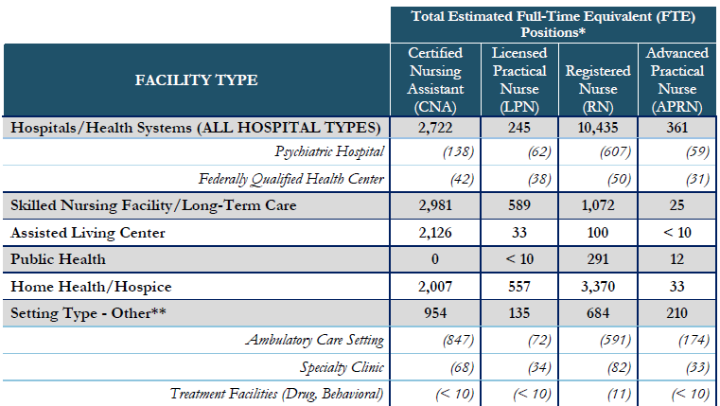
Building Workforces from Survey Data

Slide 22
Use of Contract Labor by Facility Type
 | Hospitals/ Health Systems | Skilled Nursing Facility/Long-Term Care | Assisted Living Center | Public Health | Home Health/ Hospice
CNA | 6% | 0% | 2% | 0% | 7%
LPN | 0% | 4% | 0% | 0% | 5%
RN | 11% | 4% | 11% | 22% | 7%
APRN | 4% | 4% | 1% | 11% | 2%

Slide 23
Top Three Most Difficult to Fill Positions
Hospitals/ Health Systems | Skilled Nursing Facility/Long-Term Care | Assisted Living Center | Public Health | Home Health/ Hospice
- Case Managers/ Discharge Planners - Critical Care - Labor and Delivery/ Postpartum Care | - Rehabilitation - Primary Care - Case Managers/ Discharge Planners | - Nurse Administrators - Primary Care - Hospice | - Public Health - Immunization - Nurse Administrator | - Hospice - Case Managers/ Discharge Planners - Nurse Administrator

Slide 24
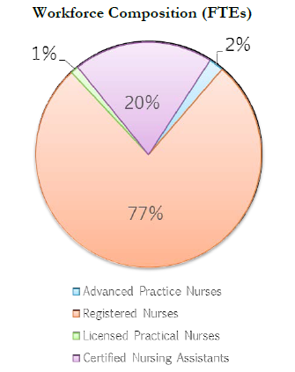
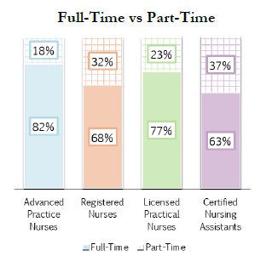
Composition of Health Systems

Slide 25
Turnovers/ Vacancies- Health Systems
Turnover Rate= | ∑ Separations (FTEs)
 | ∑ Total Budgeted FTEs
How many individuals left an organization in the last year
Vacancy Rate= | ∑ Vacant (FTEs)
 | ∑ Total Budgeted FTEs
Positions that are both budgeted for and actively being recruited for

Slide 26
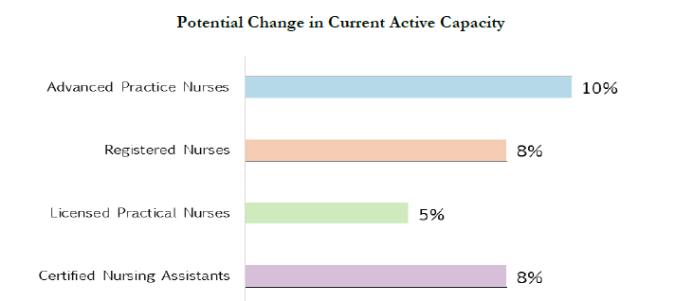
Active Capacity- Health Systems
Change in Current Active Capacity= | ∑ New FTEs + Vacant FTEs
 | ∑ Total Budgeted FTEs for 2016 (Including new FTEs)

Slide 27
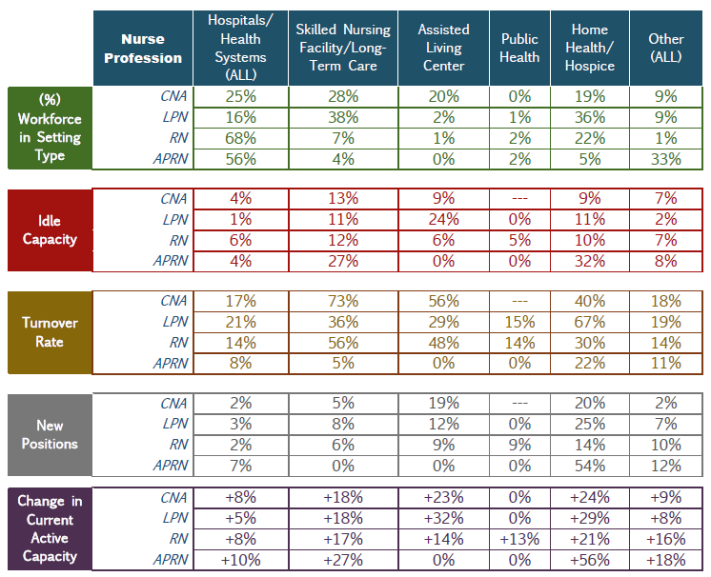

Slide 28
Questions?

